Slide 1

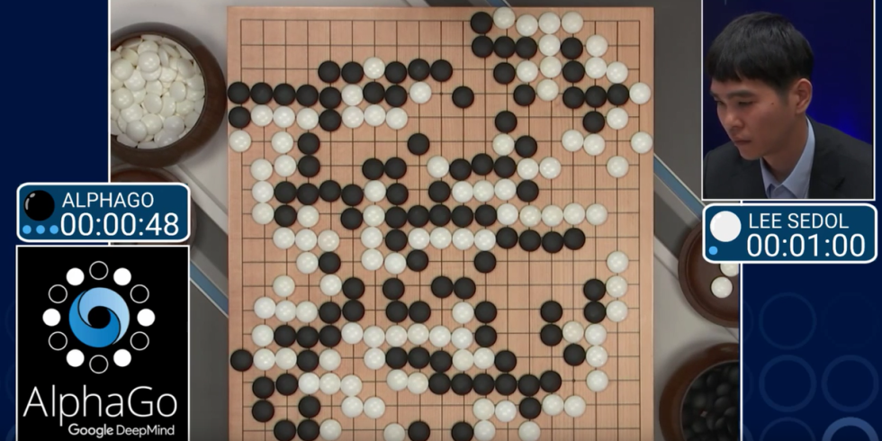
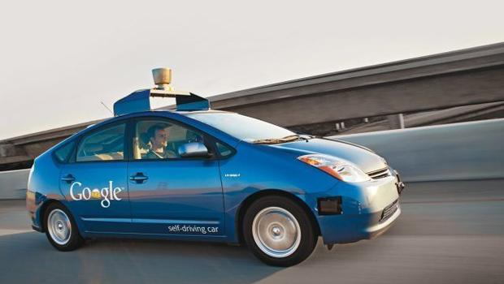
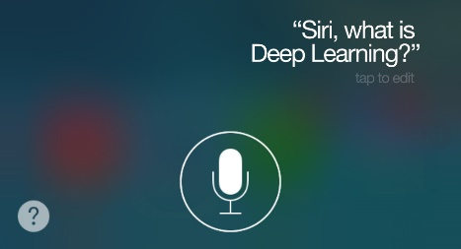
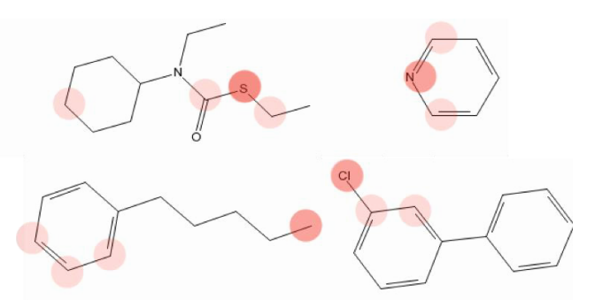
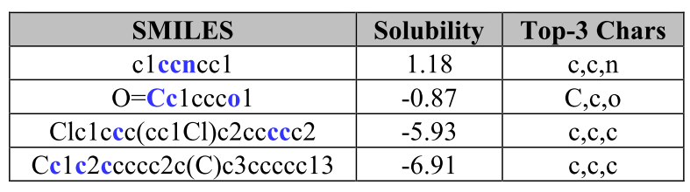
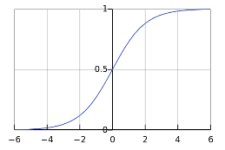
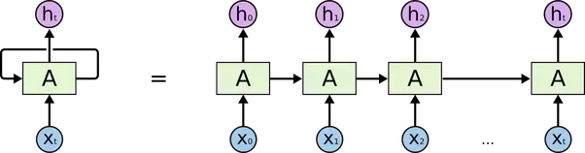

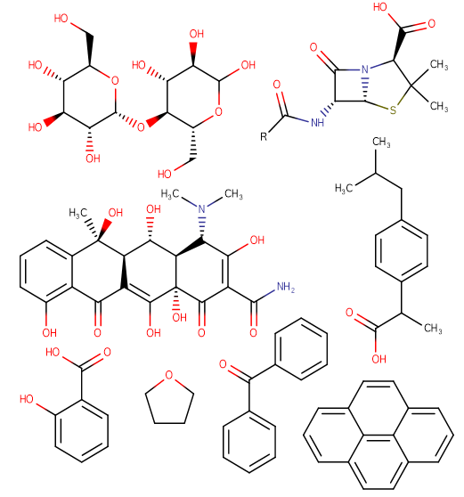
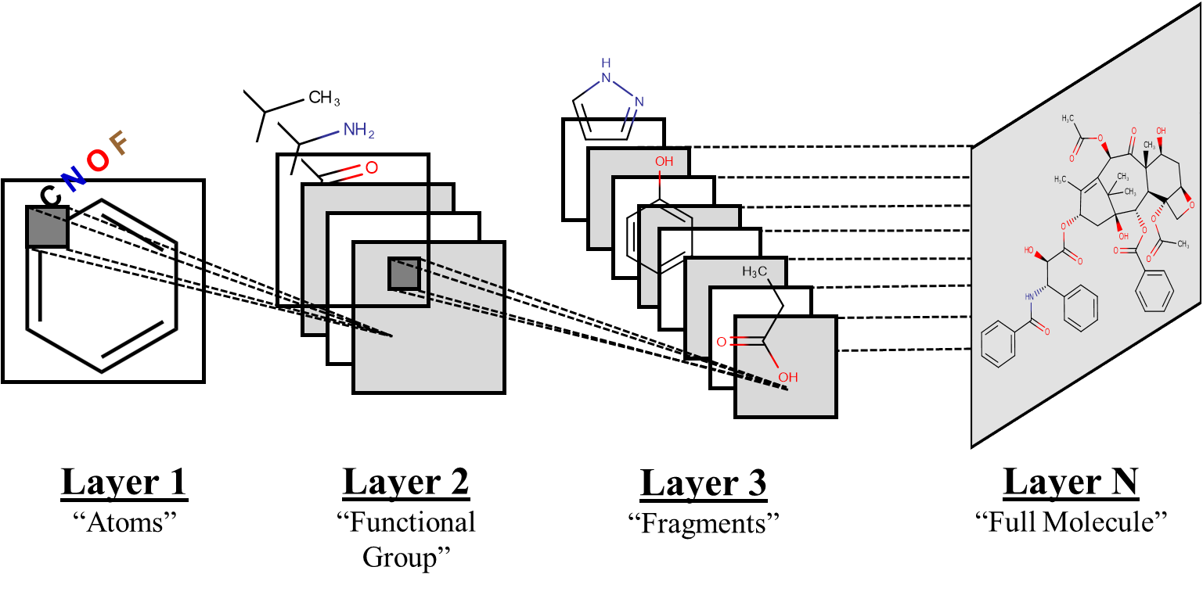


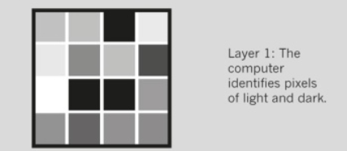
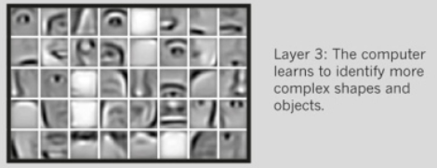
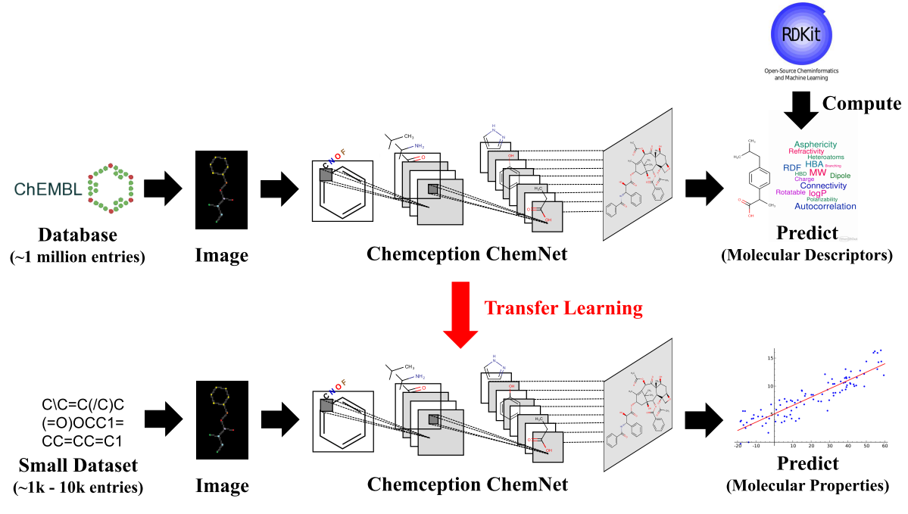
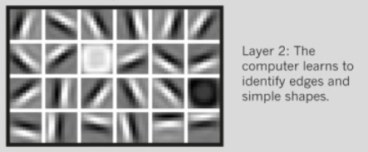
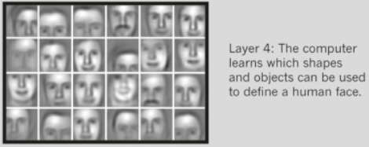
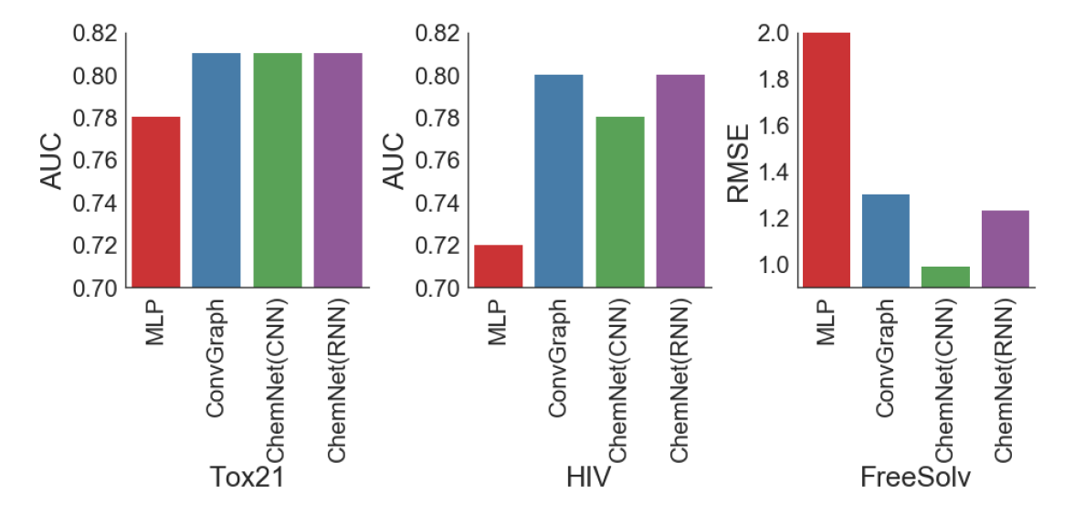


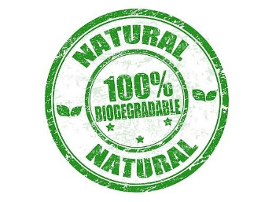

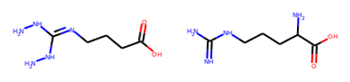
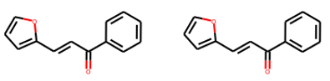
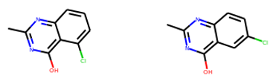
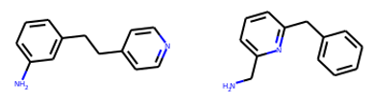




Emerging Trends in Deep Learning for the Chemical Sciences
Garrett B. Goh,^{1,}* Sijia Xiao, ² Yiming Sui, ³ Luocheng Huang, ³
^{1,}*
¹ Pacific Northwest National Lab, PCSD | ² University of Washington, Chemical Engineering | ³ University of Washington, Material Science and Engineering
Deep Learning 101
Results
SMILES2vec
Uses chemical “text representation” (SMILES strings) to develop the first deep Recurrent Neural Network (RNN) model with “universal” network design for broad & generalizable chemical property prediction
Overall equivalent performance to Augmented Chemception, but with interpretability with 88% top-3 accuracy for solubility predictions
Chemception
“Chemical Inception” first deep Convolutional Neural Network (CNN) model with “universal” network design for broad & generalizable chemical property prediction
Developed with minimal feature engineering (i.e. descriptor research), augmented with basic chemical information
Better performance than existing MLP DL models using engineered features (molecular fingerprints)
What is Deep Learning?
Deep Learning = Deep Neural Networks
Why Deep Learning?
The key is Representation Learning = Automated Feature Engineering
Minimal (close to zero) domain expert knowledge required
“Training” paradigm vs “Programming” paradigm
Many Hidden Layers
Physiological
e.g. Toxicity
Input
(Features)
Output
(Prediction)
Physiological
e.g. Toxicity
C\C=C(/C)C
(=O)OCC1=
CC=CC=C1
Biochemical
e.g. Activity
Neuron
Neural Network
Biochemical
e.g. Activity
SMILES
“Chemical Text”
SMILES2vec
Physical
e.g. Solvation
Chemical
Drawings
Physical
e.g. Solvation
Chemception
ChemNet
Deep neural network that is pre-trained to learn basic chemistry concept using weak supervision
Improves Chemception & SMILES2vec, achieves best performance & fastest training time, equivalent performance to existing state-of-the-art DL models
ABOUT
Pacific Northwest
National Laboratory
The Pacific Northwest National Laboratory,
located in southeastern Washington State,
is a U.S. Department of Energy Office of
Science laboratory that solves complex
problems in energy, national security, and
the environment, and advances scientific
frontiers in the chemical, biological, materials,
environmental, and computational sciences.
The Laboratory employs nearly 5,000 staff
members, has an annual budget in excess
of $1 billion, and has been managed by
Ohio-based Battelle since 1965.
For more information on the science
you see here, please contact:
Garrett B. Goh
Pacific Northwest National Laboratory
P.O. Box 999, MS-IN: X#-##
Richland, WA 99352
(509) 372-6291
garrett.goh@pnnl.gov
Goals
Traditional DL
QSAR/QSPR
PNNL
PNNL
Towards a data-driven research paradigm by leveraging deep learning (representation learning)
Can we develop models when we know minimally about how it works?
Proof of concept in chemistry domain, applied in property prediction
Our bottom-up “know nothing” approach is domain agnostic, eminently transferable to other PNNL research domains
PNNL
Deep Learning
Physiological
Toxicity (10k cpds)
Biochemical
Activity (10k cpds)
Biodegradability (1k cpds)
Physical
Solvation Energy (1k cpds)
Solubility (1k cpds)
GenChem
Prototype network design to solve the “inverse problem” in chemical design & identification
Actual Identity
Suggested Identity
Actual Identity
Suggested Identity
Experiments
Modeling
File Name // File Date // PNNL-SA-#####
List of design requirements
Generator
Suggest chemicals
Selected References
[1] Invited Review: Goh, G.B.;* Hodas, N.O.; Vishnu, A. J. Comput. Chem. 2017, 38, 1291–1307
[2] Chemception: Goh, G.B.;* Siegel, C.; Vishnu, A.; Hodas, N.O.; Baker, N.A. J. Chem. Inf. Model. 2017 (in review)
[3] AugChemception: Goh, G.B.;* Siegel, C.; Vishnu, A.; Hodas, N.O.; Baker, N.A. WACV. 2018
[4] SMILES2vec: Goh, G.B.;* Hodas, N.O.; Siegel, C.; Vishnu, A.. IEEE Big Data 2018 (in review)
[5] ChemNet: Goh, G.B.;* Siegel, C.; Vishnu, A.; Hodas, N.O. SIGKDD 2018
[6] DeepBiodD: Goh, G.B.*; Sakloth, K.; Siegel, C.; Pfaendtner, J; Vishnu, A. ICDM 2018 (in review)
[7] IL-Net: Sakloth, K.; Pfaendtner, J; Goh, G.B.* IEEE Big Data 2018 (in review)
[8] GenChem: Goh, G.B.*; Orlate, M.; et. al. (in progress)
Notes:
NOTE: Print this poster file at 200% SCALE to result in a physical print measuring 60” wide x 36” tall. All type size notations shown above are based on the final printed size of the poster.
• Contact Digital Duplicating (375-2969, http://digitalduplicating.pnl.gov) to order poster printing and finishing services for your completed poster design.
• Remember to have your poster cleared for public display/distribution through the Information Release system (http://informationrelease.pnl.gov).
• Sidebar “About PNNL” box is considered optional, and can be removed if space is needed for technical content.

